Slide 1
OntoQuad: Native High-Speed RDF DBMS for Semantic Web
Alexander Potocki¹, Anton Polukhin¹, Grigory Drobyazko², Daniel Hladky²,
Victor Klintsov², and Jörg Unbehauen³
¹ Eventos, Moscow, Russia
{alexander.potocki, anton.polukhin}@my-eventos.com
² National Research University - Higher School of Economics (NRU HSE), Moscow, Russia
{gdrobyazko, vklintsov, daniel.hladky}@hse.ru
³ Universität Leipzig, Institut für Informatik, Leipzig, Germany
unbehauen@informatik.uni-leipzig.de

Slide 2
General Information
OntoQuad General Information

Slide 3




Supported Standards and Platforms
OntoQuad
Is developed with the latest C++ Standard (C++11) from zero
is compliant with the latest standards of the W3C (e.g. RDF, SPARQL 1.1)
supports Java (Jena) API
works in transactional mode
OntoQuad is cross-platform and can be deployed on different devices:
MS Windows x64 (developed on Windows 7)
Unix/Linux x64 (tested on Linux CentOS 6.3)
Mobile Android (Samsung Galaxy Note II, Google Nexus 7 etc.)
Raspberry Pi Model B rev 2
iOS & OS X – is coming soon
Notes:
10 sec
1
2
3

Slide 4
Information Architecture
Information Architecture

Slide 5
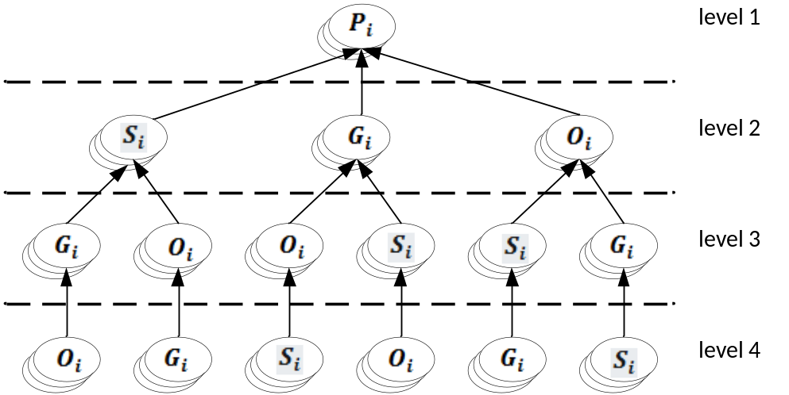
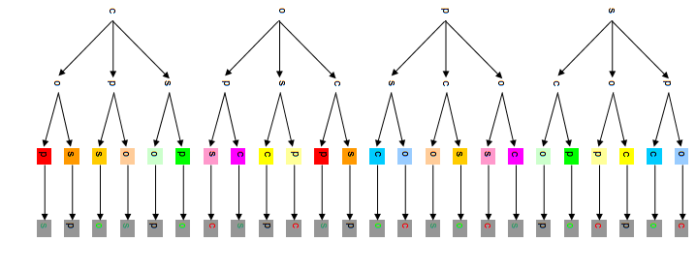
Vector Model
HexaStore & the Vector Model
In our work we elaborate on the vector representation of triples proposed for the Hexastore, by expanding it onto quadruple representation

Slide 6
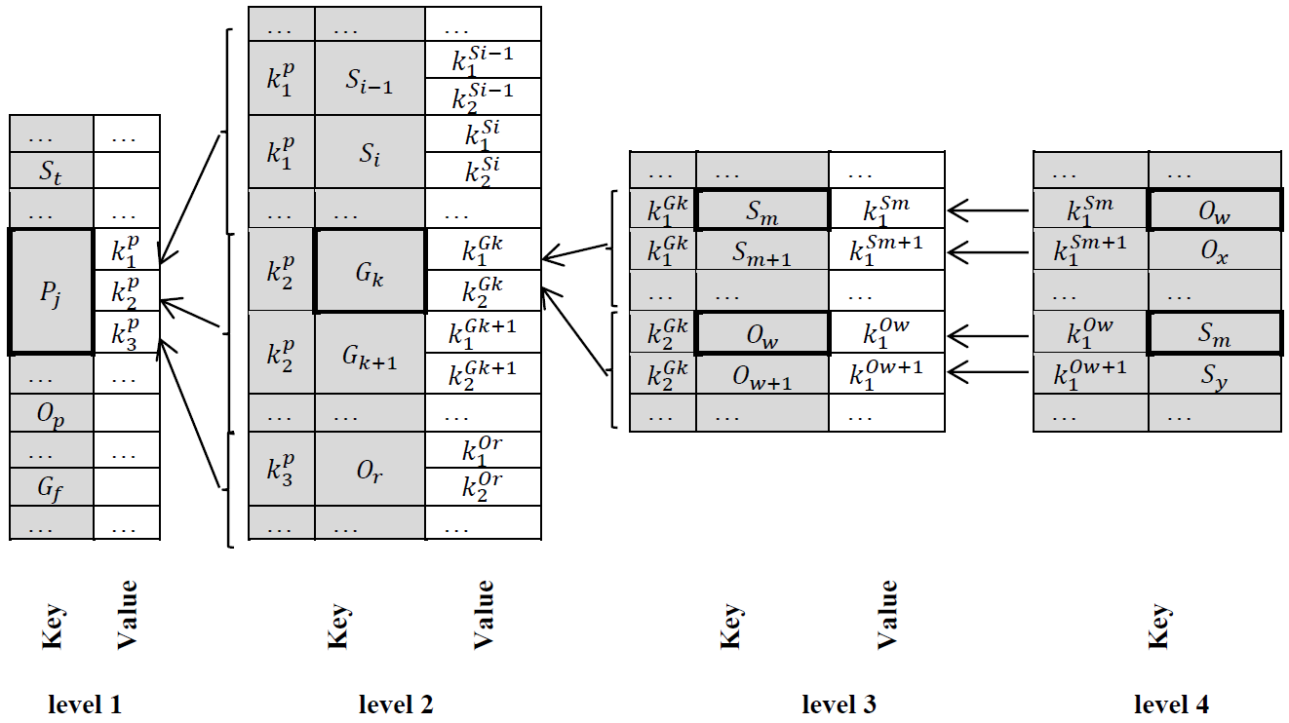
Data Storage Components
ID | Type | Value
S _{t} | IRI | <http://purl.org/dc/...>
…
P _{j} | IRI | <http://example.org/...>
…
O _{p} | xsd:dateTime | "2005-02-28T00:00:00Z"
…
G _{f} | IRI | <http://mygraph.com>
Database Structure:
Key-value indexes (Index-24)
Vocabulary
Index IDs map to Vocabulary

Slide 7
Persistence Strategy
Persistence Strategy
The DBMS creates several files for storing data. The file combines both a structure for storing data and an Key-Value index implemented as B-trees (or B*-trees) because it ensures the support of prefix range lookups.
The DBMS keeps all unique values in a separate Vocabulary, and Key-Value indexes contain references (fixed-length identifiers) to the Vocabulary items.
Vocabulary is a full lexicon of URI’s and literals that are “known” to the base which associates the values of S, P, O and G with their vocabulary ID’s that are unique within a DB instance.
Index-type configuration parameter can take four values:
polymorphic2 provides two indexes configuration. Supports PSO, POS indexes.
polymorphic6 | polymorphic6monolith provides six indexes configuration. Supports PSOG, PSGO, POSG, POGS, PGOS, PGSO indexes.
polymorphic24 provides twenty four indexes configuration. Supports all permutations (24) of four elements SPOG.
Notes:
30 sec

Slide 8
Components Architecture
Components Architecture

Slide 9
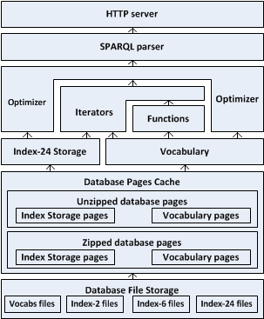
Component Scheme
Brief components description is on next page

Slide 10
Main Components
The built-in HTTP Server is a SPARQL 1.1 endpoint;
The SPARQL Parser does syntactic analysis of queries and generates of the initial QEP tree;
The Optimizer transforms the initial QEP into a new equivalent QEP with more optimal performance time and resources;
The Iterators implement SPARQL algebra operators of QEP;
The Functions are either functions of the SPARQL language or custom functions;
The Vocabulary is a comprehensive lexicon of URI’s and literals downloaded into the database;
The Index-24 implements different PSOG indexes;
The Database Page Cache (zipped and unzipped) keeps last used Index-24 and Vocabulary pages from the Database File Storage;
The Database File Storage stores the Index-24 and the Vocabulary in the B-tree (B*-tree).

Slide 11
Iterators Algorithms
Iterators Algorithms

Slide 12
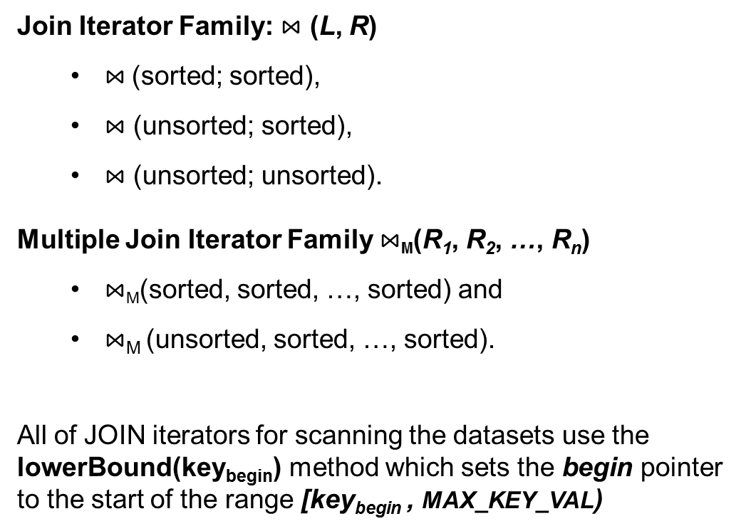
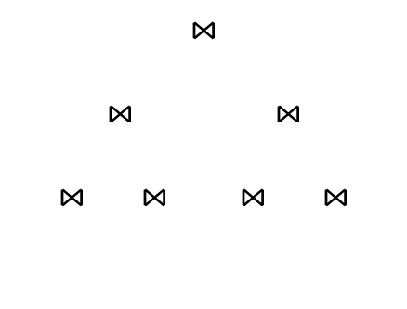


Iterators
In OntoQuad the Iterators are the main building blocks of Query Execution Plan
All of the SPARQL algebra operators are implemented by means of the Iterators
index scans iterators
index scans iterators

Slide 13
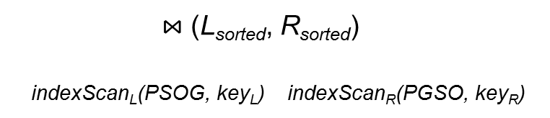
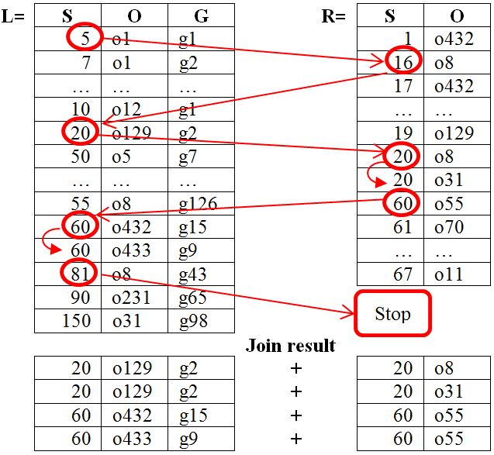

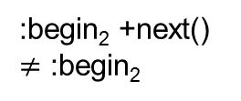

ZIG-ZAG Join Algorithm for Join Iterator
L is sorted by P, R is sorted by PG
PSOG
PSGO
POSG
POGS
PGOS
?s :p₁ ?o₁ ?g .
?s :p₂ ?o₂ :g₂ .
:p₁ ?s ?o₁ ?g .
:p₂ :g₂ ?s ?o₂ .
L
R
PGSO
L
:begin₁
key_{L}
R
:s_{j}
key_{R}
:end₂
:end₁
ordered sets of the L and R keys

Slide 14


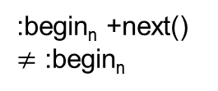

ZIG-ZAG Join Algorithm for Multiple Join Iterator
PSOG
PSGO
POSG
POGS
PGOS
?s :p₁ ?o₁ ?g .
?s :p₂ ?o₂ :g₂ .
...
?s :p_{n} ?o_{n} :g_{n} .
:p₁ ?s ?o₁ ?g .
:p₂ :g₂ ?s ?o₂ .
...
:p_{n} :g_{n} ?s ?o_{n} .
R₁
R₂
PGSO
R_{n}
lowerBound(key_{begin}) method of JOIN iterator sets begin pointer to the beginning
of the range [key_{begin} , EOF)
R₁
R₂
R_{n}
:begin_{1.1}
key_{R1}
key_{R2}
:s_{j}
:s_{j}
n times next()
key_{Rn}
...
...
ordered sets of the R₁, R₂, … and R_{n} keys

Slide 15
Execution Plan Optimization
Execution Plan Optimization
Based on Heuristics

Slide 16
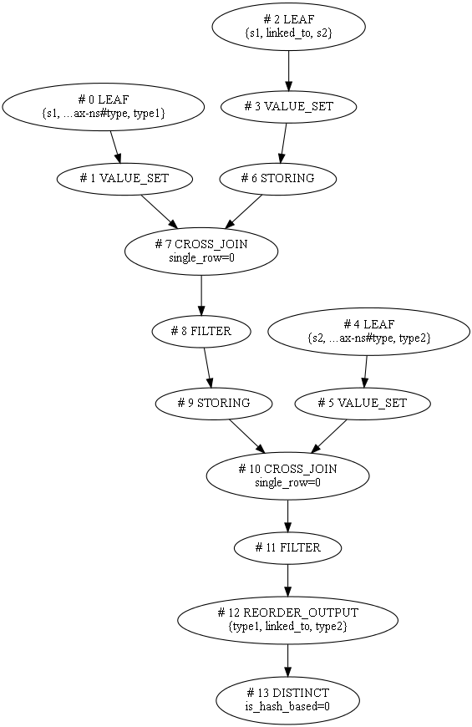
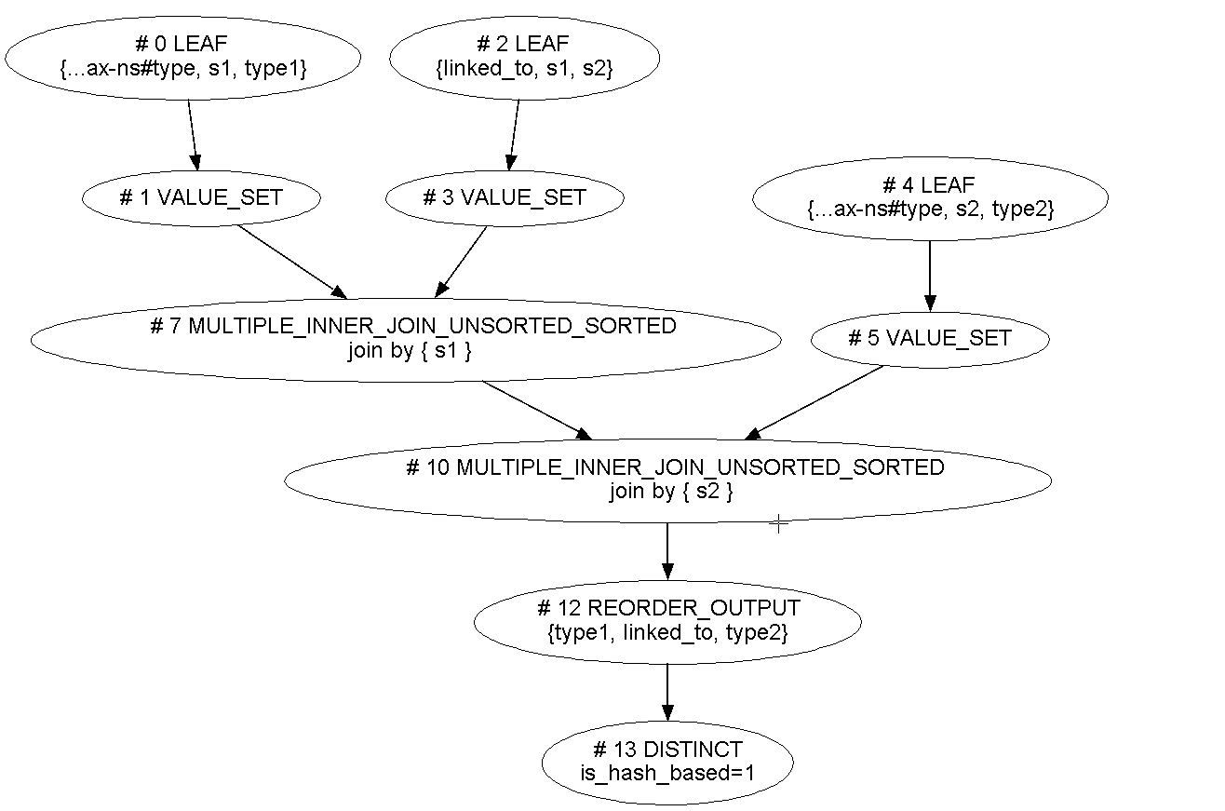
Query Execution Plan Optimization Based on Heuristics
Static Query Heuristics-based Optimizer transforms an initial Query Execution Plan D₀ into an equivalent plan D₁.
It bases on heuristic transformations of QEP.
Heuristics List Overview:
Leaf iterator constants shift
Transform Cartesian product to join
Reorder joins
Sort Minus arguments
Sort outer join arguments
Remove unrequired reordering
Execute the simplest union first
Move Projection closer to leafs
Move filters closer to leafs
Merge Distinct with Sorting
Set sorted set limit
Chose optimal distinct algorithm
Merge join with filter
Replace join with multiple join
Convert nested multiple joins to one multiple join
and something else …

Slide 17
“How it Works” Example
“How it Works” Example

Slide 18
Example. Query #5 BSBM
PREFIX rdfs: <http://www.w3.org/2000/01/rdf-schema#>
PREFIX rdf: <http://www.w3.org/1999/02/22-rdf-syntax-ns#>
PREFIX bsbm: <http://www4.wiwiss.fu-berlin.de/bizer/bsbm/v01/vocabulary/>
SELECT DISTINCT ?product ?productLabel
WHERE {
?product rdfs:label ?productLabel .
FILTER (<http://www4.wiwiss.fu-berlin.de/bizer/bsbm/v01/instances/dataFromProducer3475/Product175673>
!= ?product)
<http://www4.wiwiss.fu-berlin.de/bizer/bsbm/v01/instances/dataFromProducer3475/Product175673>
bsbm:productFeature ?prodFeature .
?product bsbm:productFeature ?prodFeature .
<http://www4.wiwiss.fu-berlin.de/bizer/bsbm/v01/instances/dataFromProducer3475/Product175673>
bsbm:productPropertyNumeric1 ?origProperty1 .
?product bsbm:productPropertyNumeric1 ?simProperty1 .
FILTER (?simProperty1 < (?origProperty1 + 120) && ?simProperty1 > (?origProperty1 - 120))
<http://www4.wiwiss.fu-berlin.de/bizer/bsbm/v01/instances/dataFromProducer3475/Product175673>
bsbm:productPropertyNumeric2 ?origProperty2 .
?product bsbm:productPropertyNumeric2 ?simProperty2 .
FILTER (?simProperty2 < (?origProperty2 + 170) && ?simProperty2 > (?origProperty2 - 170))
}
ORDER BY ?productLabel LIMIT 5

Slide 19
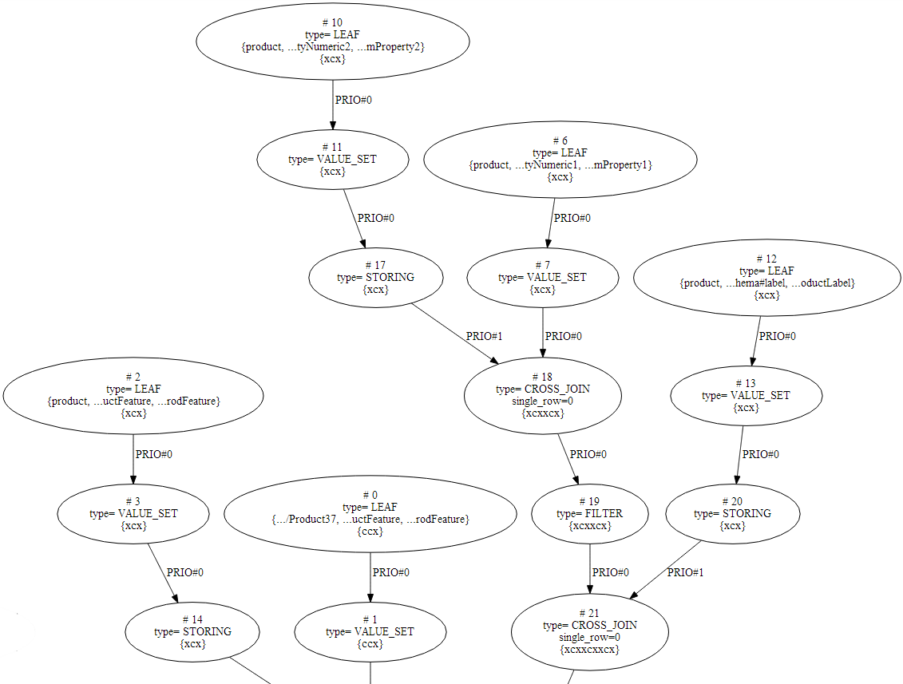
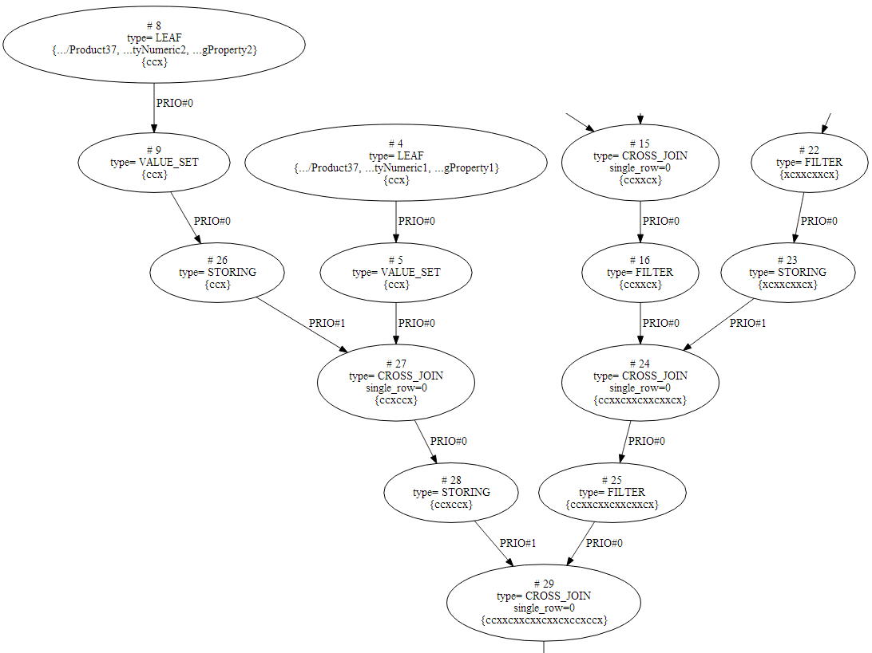
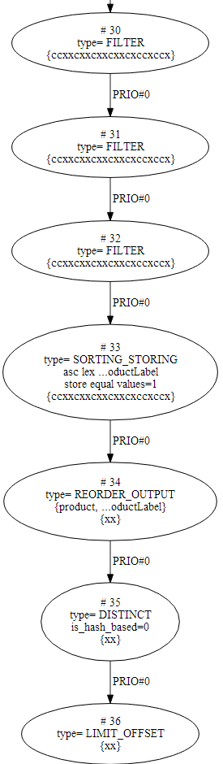
Initial QEP Before the Transformations
1
2
3
4
1
2
3
4

Slide 20
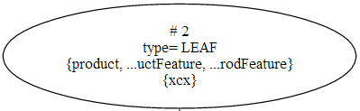
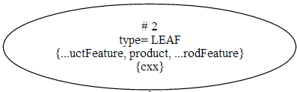
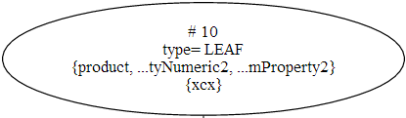
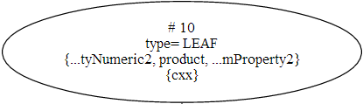
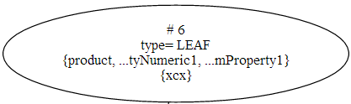
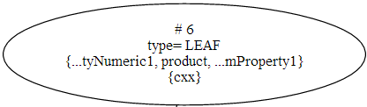
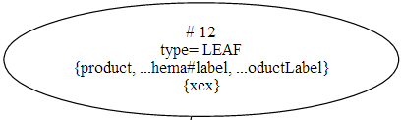
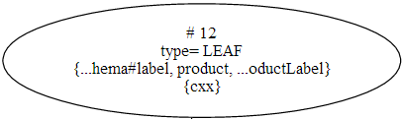
“Leaf Iterator Constants Shift” Heuristic
?product bsbm:productFeature ?prodFeature .
bsbm:productFeature ?product ?prodFeature .
“Leaf iterator constants shift” move constants to the beginning

Slide 21
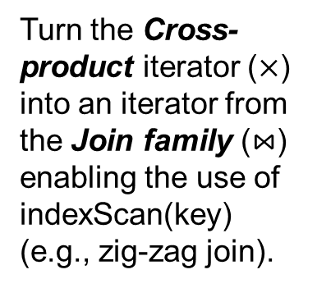
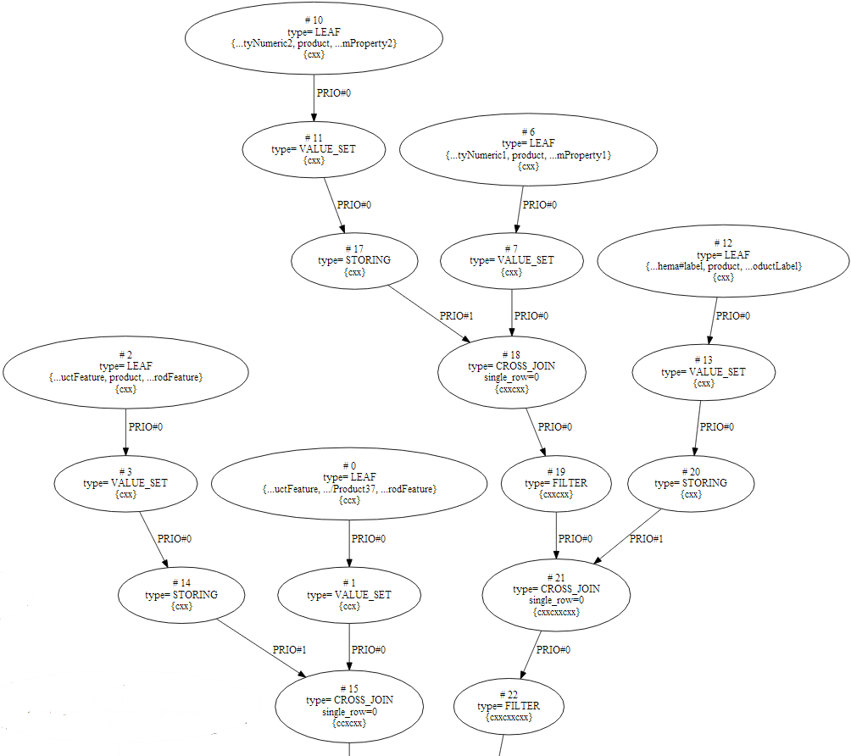

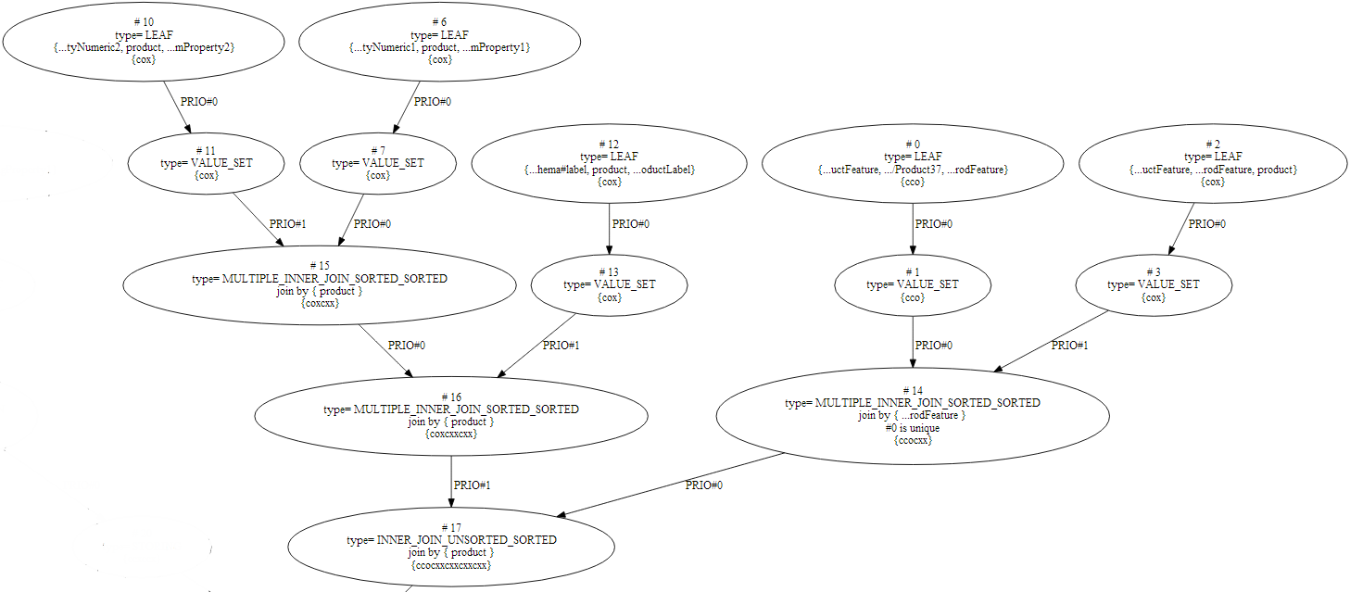
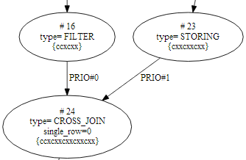
“Transform Cartesian Product to Join” Heuristic
?product bsbm:productPropertyNumeric2 ?simProperty2 .
?product bsbm:productPropertyNumeric1 ?simProperty1 .
?product rdfs:label ?productLabel .
2
3
1
4
2
3
1
4

Slide 22


“Replace Join with Multiple Join” Heuristic
The multiple join operator can be used instead of the join operator even in case of just two input arguments because of it is faster in our implementation.

Slide 23
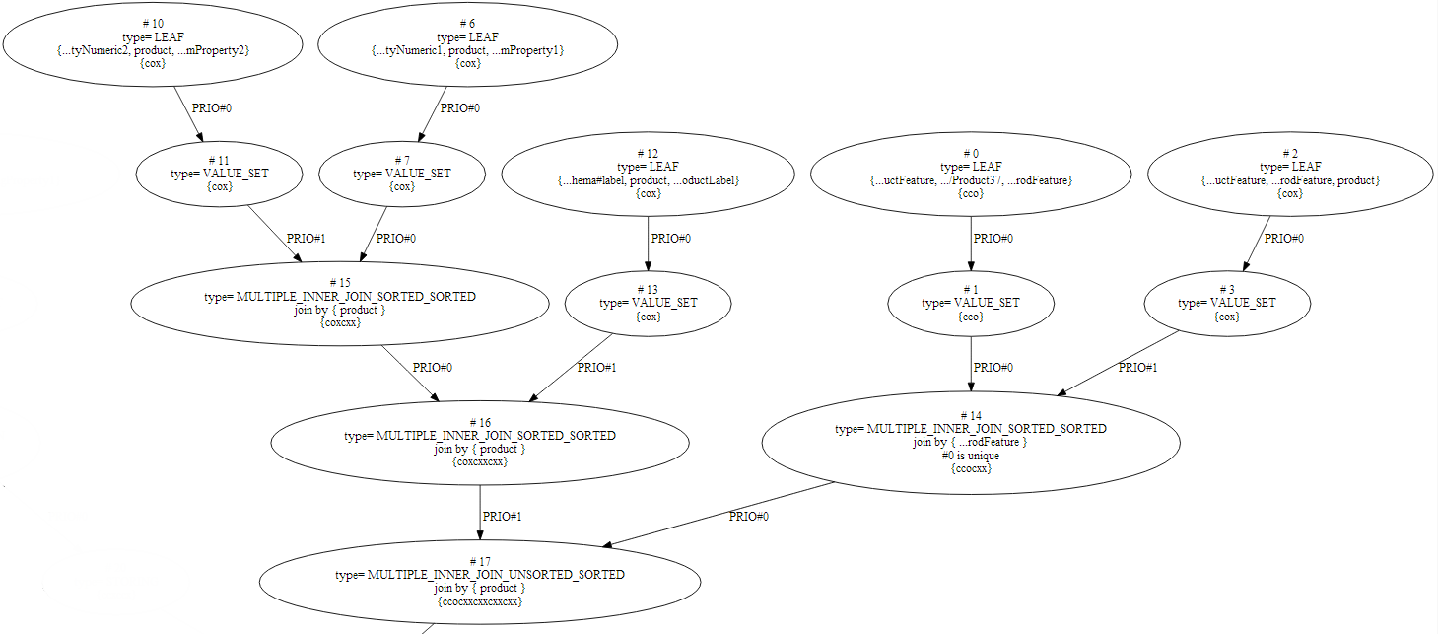
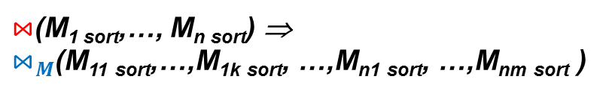
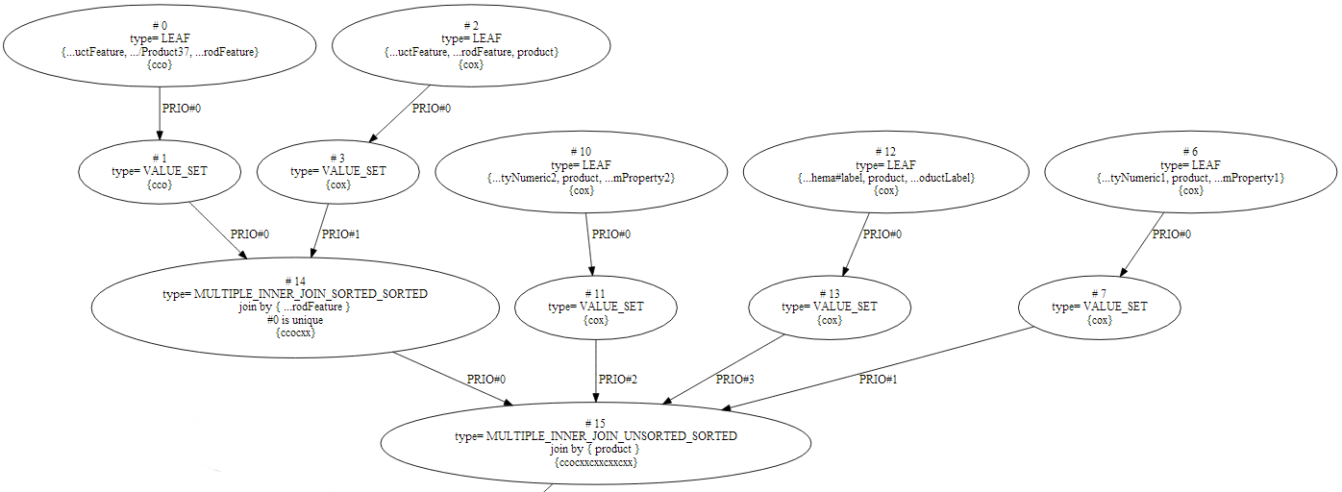
“Convert Nested Multiple Joins to One Multiple Join” Heuristic
The transformation converts several nested multiple join operators with identically sorted join variables into a single multiple join operator
Nested Multiple Joins

Slide 24
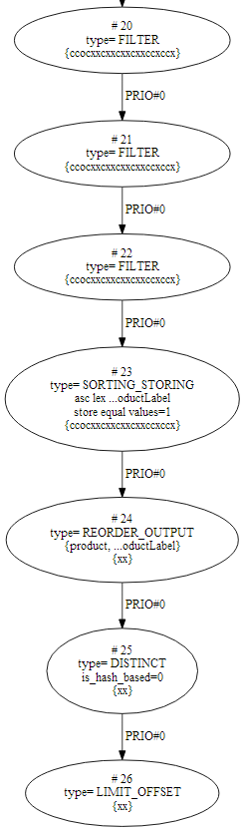
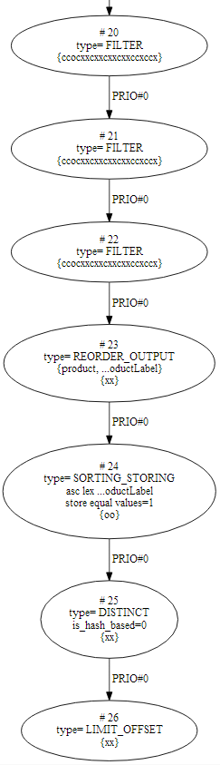


“Move Reordering Closer to the Leafs” Heuristic
ORDER BY ?productLabel
We also use a similar heuristic
“Move Projection closer to leafs”

Slide 25

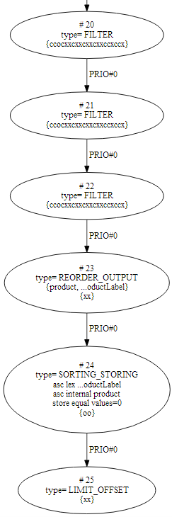
“Merge Distinct with Sorting” Heuristic
If a Select clause contains the Distinct and Order by solution modifiers, we replace them by a new iterator performing simultaneously the duplicate tuple removal and sorting functions
SELECT DISTINCT ?product ?productLabel
WHERE {
…
} ORDER BY ?productLabel LIMIT 5

Slide 26
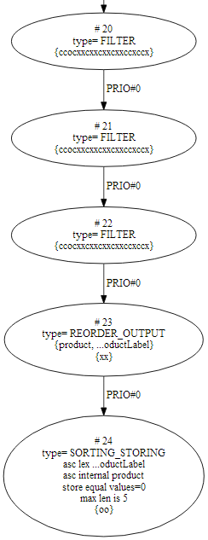
“Set Sorted Set Limit” Heuristic
If a Select clause contains the Order by and Limit solution modifiers, then we create a sorted set with a size specified in the Limit for storing resulting tuples
SELECT DISTINCT ?product ?productLabel
WHERE {
…
} ORDER BY ?productLabel LIMIT 5

Slide 27
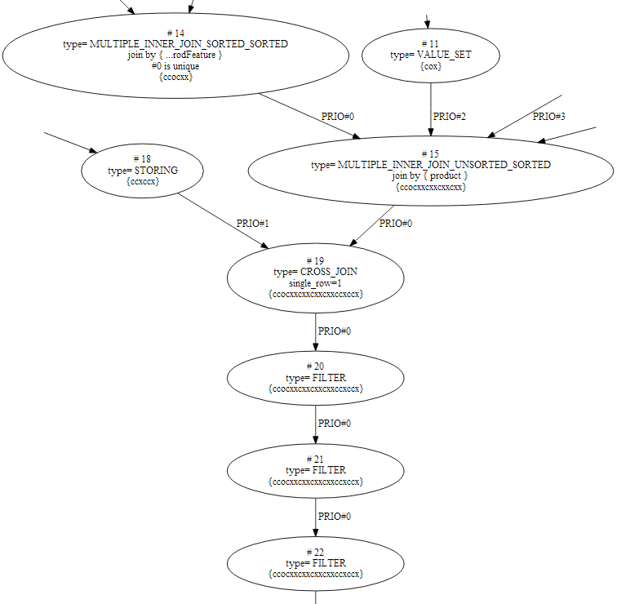
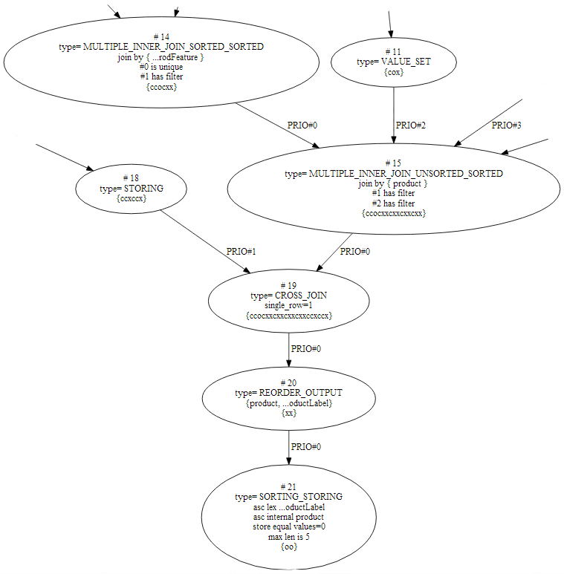
“Move Filters Closer to Leafs” Heuristic
If a QEP tree contains the join, outer join, Cartesian product, sort operators, then the heuristic tries to move a filter
in the QEP tree closer to the leaf nodes, placing it before these operators
σ_{F}(…op(L₁,R₁)…) ⇒
op(… (…σ_{F1}(Ω1)…σ_{F2}(Ω2)…)…)
WHERE {
FILTER (<http://.../Product175673> != ?product)
...
FILTER (?simProperty1 < (?origProperty1 + 120) && ?simProperty1 > (?origProperty1 - 120))
...
FILTER (?simProperty2 < (?origProperty2 + 170) && ?simProperty2 > (?origProperty2 - 170))
} ORDER BY ?productLabel LIMIT 5

Slide 28
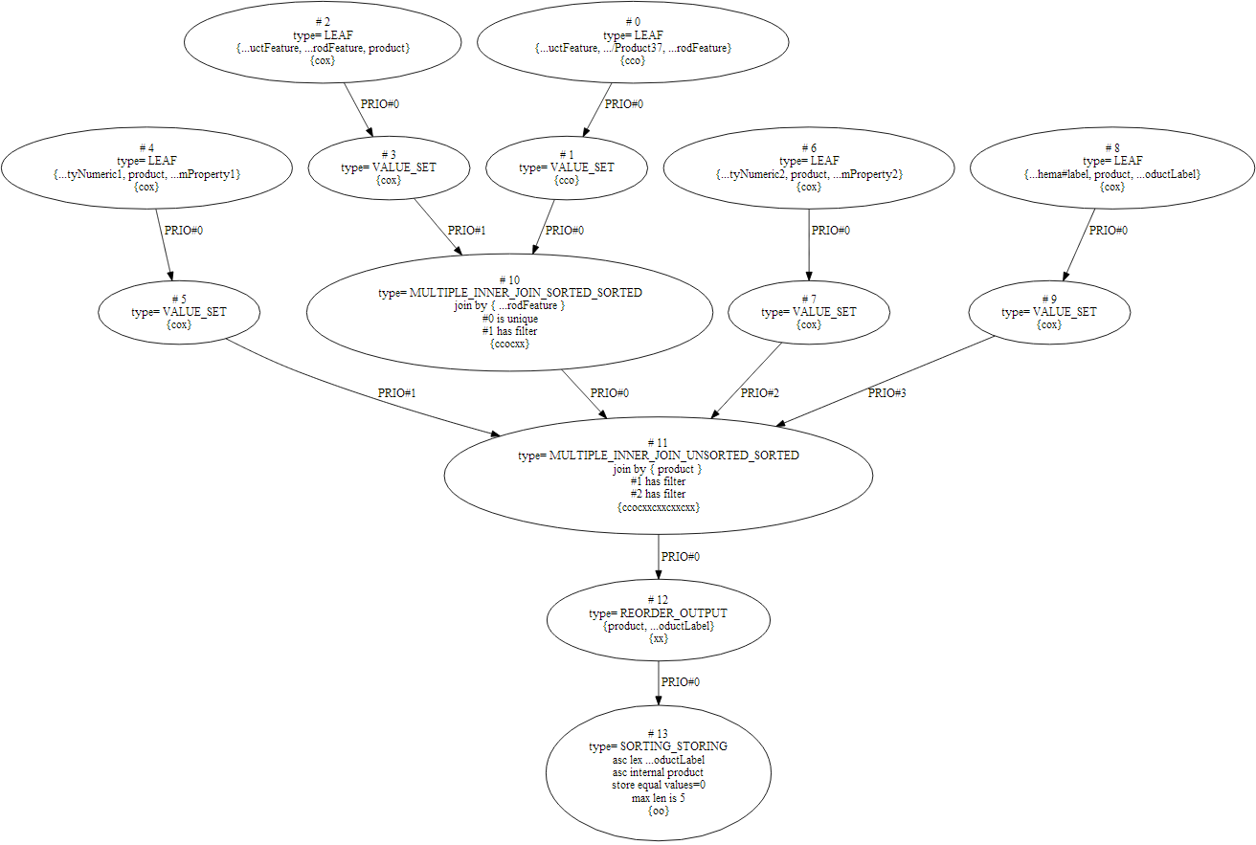
Resulting QEP
As the result of the
transformations we have
short, more efficient and
fast QEP then it was at the start

Slide 29
BSBM Evaluation
BSBM Evaluation

Slide 30
1-st stage of the Benchmarking: Conditions and Characteristics
The 1-st stage was run in June 2013 in Universität Leipzig, Institut für Informatik, Germany
Benchmark machine
quad-core Intel i7-3770 CPU with 32 GB of RAM.
storage is 2x2 TB 7200rpm SATA hard drives, configured as software RAID 1.
Benchmark
Berlin SPARQL Benchmark (BSBM) Specification - V3.1, Explore Use Case
The database size varied from 10 million triples, 100 million triples and 1 billion triples, runs done for 1, 4, 8, 16 parallel clients.
All systems were configured to use 22GB of main memory.
Three RDF DBMS were compared to OntoQuad
Virtuoso 6.1.6,
Jena TDB (Fuseki 0.2.7) and
BigData (Release 1.2.2).

Slide 31
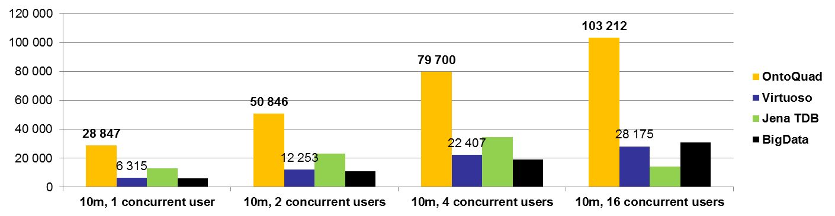
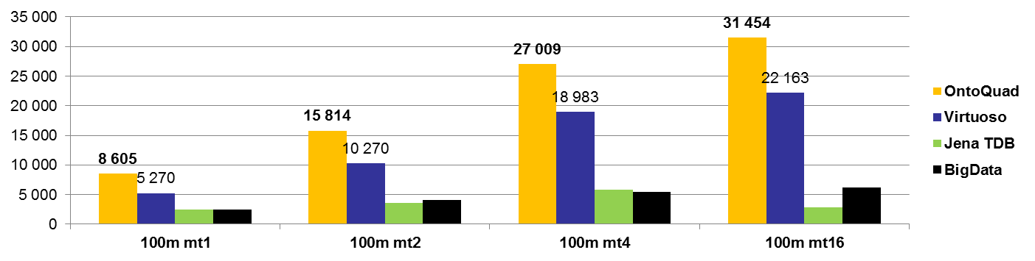
1-st stage of the Benchmarking: BSBM Explore Use Case
QMpH for 10 and 100 Millions of Triples
Query Mix per Hour for 10 millions of the triples dataset
Query Mix per Hour for 100 millions of the triples dataset

Slide 32
2-nd stage of the Benchmarking: Conditions and Characteristics
The 2-nd stage was run in August - September 2013 in National Research University - Higher School of Economics, Semantic Technology Centre, Moscow, Russia. The only RDF DBMS compared to the latest version of OntoQuad is Open source Virtuoso branch stable/7 – the leader of the BSBM tests
Benchmark machine
VMware Virtual Platform installed on the machine with 8 processors Intel(R) Xeon(R) (16 hyper threading core) CPU X5550@2.67GHz,
SCSI storage controller: LSI Logic / Symbios Logic 53c1030 PCI-X Fusion-MPT Dual Ultra320 SCSI, HDD 969 GB.
29 GB RAM, 15 GB of swap area
Benchmark
Berlin SPARQL Benchmark (BSBM) Specification - V3.1, Explore Use Case.
The database size varied from 100 million, 200 million and 500 million triples, runs done for 1, 4, 8, 16, 32, 64 parallel clients.
We used a reduced set of the query mix. Query #9 (DESCRIBE) has been excluded.

Slide 33
2-nd stage of the Benchmarking:
Virtuoso and OntoQuad Performance Tuning
Both Virtuoso and OntoQuad were configured to use 24 GB of main memory
Virtuoso 7
Was set up according to RDF Performance Tuning of the Virtuoso Open-Source Wiki.
MaxCheckpointRemap = 200000
NumberOfBuffers = 2040000
MaxDirtyBuffers = 1500000
CheckpointInterval = 600
OntoQuad
cachesize = 11811160064
compressed-page-cachesize = 13958643712

Slide 34
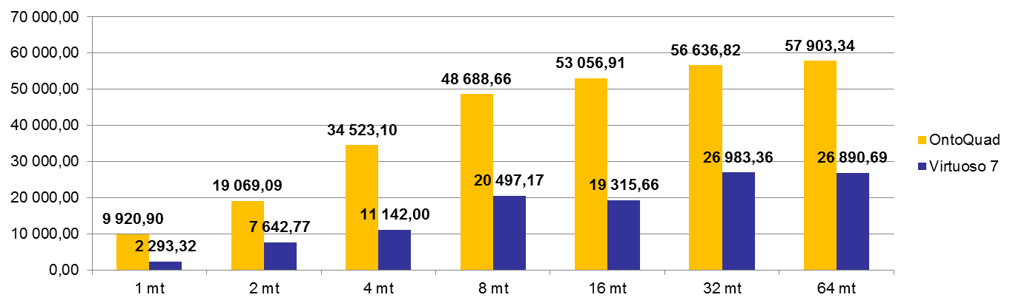
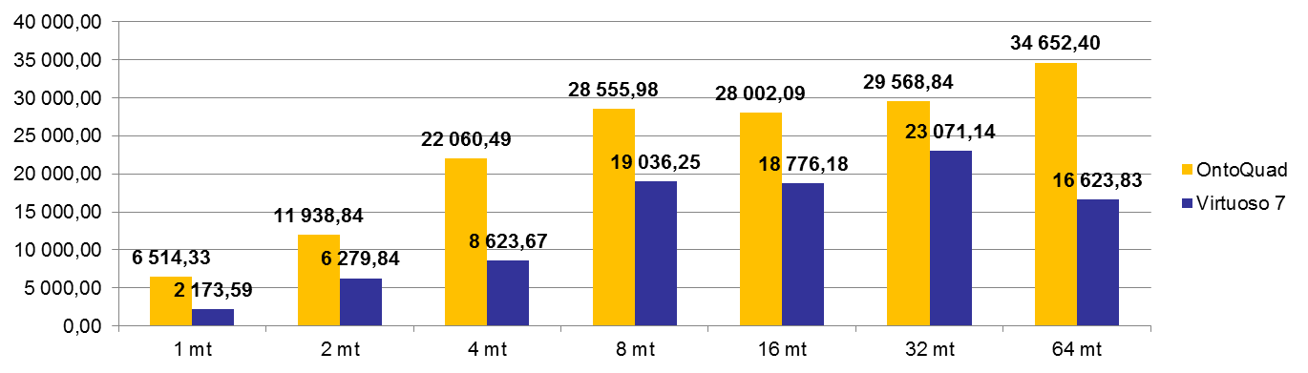
2-st stage of the Benchmarking: BSBM Explore Use Case
QMpH for 100 and 200 Millions of Triples
Query Mix per Hour for 100 millions of the triples dataset
Query Mix per Hour for 200 millions of the triples dataset

Slide 35
2-st stage of the Benchmarking: BSBM Explore Use Case
QMpH for 500 Millions of Triples
Query Mix per Hour for 500 millions of the triples dataset
Query Mix per Hour for 200 millions of the triples dataset

